Slide 1
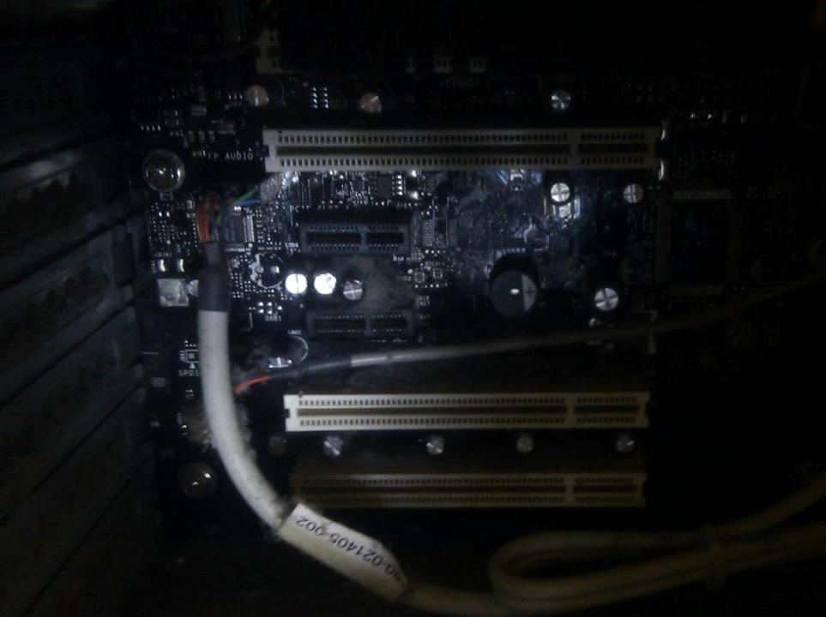

Computing Systems
Lecture 6
Networks

Slide 2
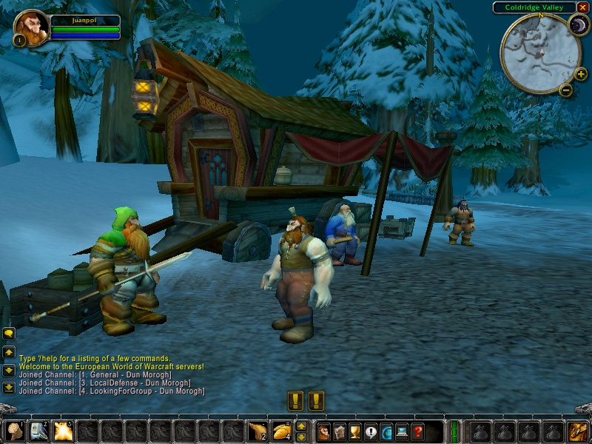
From Colossus to
World of Warcraft
Notes:
Starting with a view of some of the forms of current networking applications that exist..

Slide 3
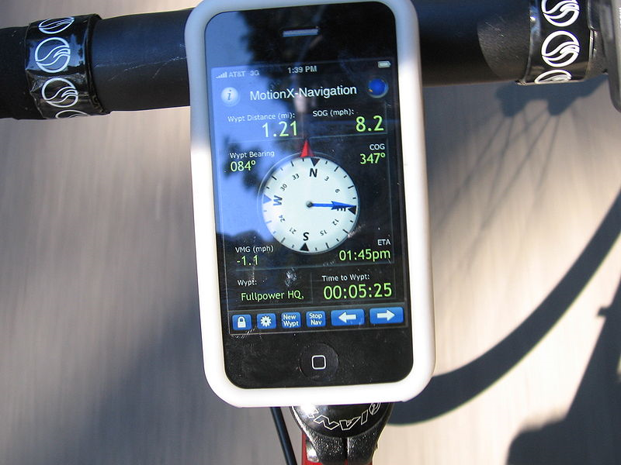
Notes:
Modern smartphones include a wide array of networking capabilities – mobile internet, bluetooth (short range connectivity, to headsets or even to allow the phone to act as an input device for a PC) and access to GPS (global positioning data – phone receives signals from satellites)

Slide 4
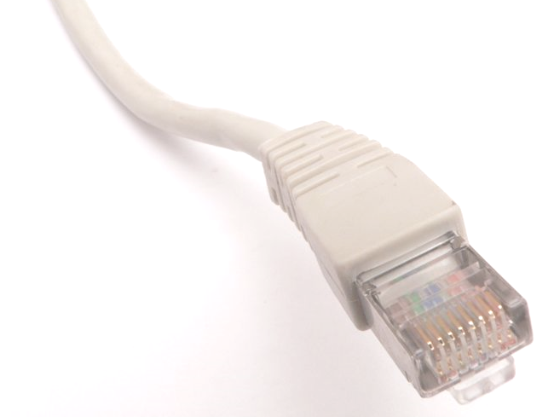
Early Multi-User Computing
Early computers were standalone
  no communication between different computers
Development of terminals allowed multiple users (possibly in different locations) to use the same computer at the same time
  Terminal only used for keyboard input and text output (screen or printer)
Later generations of terminals added graphics & local processing (e.g. PLATO IV)

Slide 5
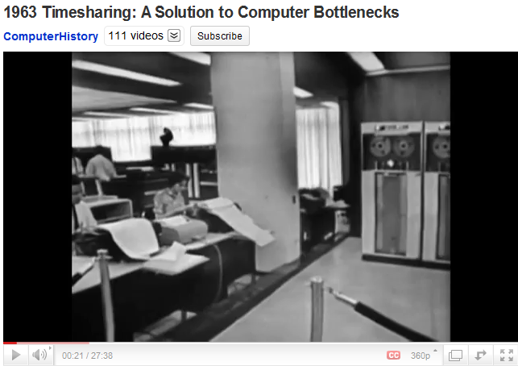
Notes:
Click to launch video
In lecture watch only first minute of this – watch as much as you would like at home!

Slide 6
ARPANET
Computer network developed to link researchers to the limited number of powerful research computers in the US
  Not (as often said) to create a network that would survive a nuclear attack
Removing the need for separate terminals for each computer, a single terminal could connect to any computer on the network
Notes:
Not to survive nuclear attack, but to survive the loss of individual nodes without compromising the whole network

Slide 7
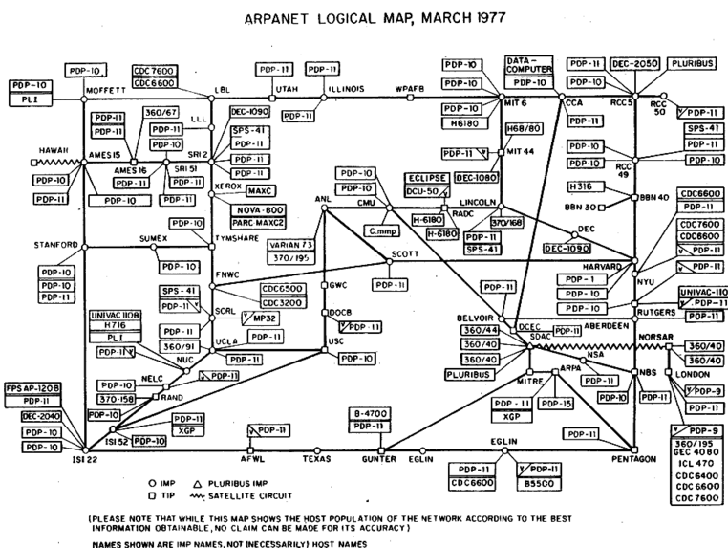
Circuit vs Packet Switching
Circuit switching creates persistent link between endpoints
  Any single node failure breaks the entire link
Packet Switching breaks message into small packets, each with information on destination
  Each packet forwarded one hop at a time
  Packets from a single message may take different routes to destination
Notes:
Early attempts at networking suffered if a single node on the network failed
Circuit switching creates a point to point connection through an entire network; connection lost if any node fails
Packet Switching allows successful communication even where nodes fail
Message split into chunks
Each chunk passed around the network from node to node in direction of destination
Donald Davies (NPL,UK)
Also Paul Baran (US) – Message Blocks

Slide 8
Data Packets
Data sent between machines sent in packets
  Large data transfers broken into multiple packets
Each packet contains
  IP (Internet Protocol) addresses of destination & sender
  Packet sequence number
  Data contents
  Cyclic Redundancy Check (CRC) data to verify correct transmission of packet
Notes:
HCW p317

Slide 9
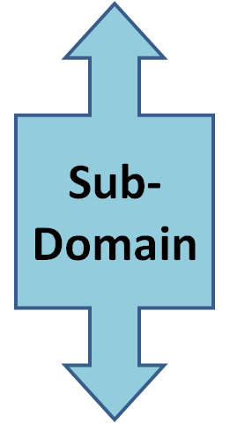


Domain Names
http://www.uws.ac.uk/
some.user@uws.ac.uk
Sub-Domain
Notes:
ccTLD = country code Top Level Domain. Alternative TLDs include .com and .edu (mainly North America and international use)
ccSLD = country code second level domain. In some countries (including UK) only a restricted set of SLDs are available – e.g. .co.uk for companies, .ac.uk for academic sites, .gov.uk, etc etc. Other countries allow any SLD which can be used creatively eg. .ly is the TLD for Libya which is used for e.g. bit.ly (a url shortening service)

Slide 10
OSI Seven Layer Model
Splits network communications into a set of different layers:
  Application, Presentation, Session, Transport, Network, Data Link, Physical
  From user programs (web-browsers and online games) to the physical links between nodes
Each uses the layer below, but doesn’t need to know how the lower level works
  Multi-user game does not need to know how the machines are actually physically connected, browser doesn’t know if I’m using WiFi or 3g...
Notes:
HCW p 334

Slide 11
TCP/IP
Transmission Control Protocol/Internet Protocol
TCP is a transport layer protocol
IP is a network layer protocol
Each node on the internet has an IP address
www.uws.ac.uk = 146.191.60.100
Special servers known as Domain Name System Servers map node names to IP addresses
Notes:
All machines on the internet have an IP address.
The current IP addressing system (IPv4) is running out of addresses, the new system (IPv6) is coming online – but not all online yet.

Slide 12
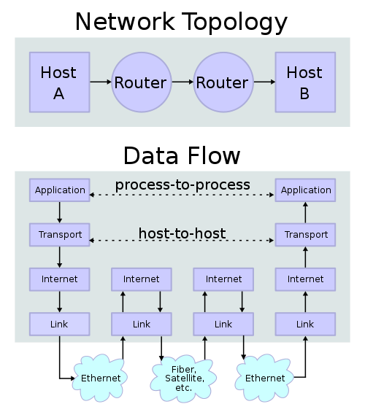
Notes:
Applications don’t necessarily know much about what is happening in the lower layers. One application makes a connection to another, while under the hood a range of other protocols are used to create the connections and transfer data
In this example the two host machines don’t need to know about the particular networks in use
This diagram shows the Internet Protocol Suite of layers.

Slide 13
C:\Users\admin>tracert 146.191.60.100
Tracing route to uws.ac.uk [146.191.60.100] over a maximum of 30 hops:
1 67 ms <1 ms 1 ms XXXXXXX-XxX [192.168.2.1]
2 36 ms 40 ms 34 ms xx.xxx.xxx.x
3 24 ms 16 ms 25 ms renf-cam-1b-v125.network.virginmedia.net [80.4.64.245]
4 44 ms 18 ms 44 ms renf-core-1b-ae2-0.network.virginmedia.net [195.182.176.181]
5 40 ms 26 ms 19 ms leed-bb-1b-as3-0.network.virginmedia.net [213.105.175.225]
6 32 ms 36 ms 27 ms leed-bb-1a-ae0-0.network.virginmedia.net [62.253.187.185]
7 27 ms 24 ms 20 ms brnt-bb-1b-as2-0.network.virginmedia.net [213.105.175.26]
8 51 ms 29 ms 28 ms brnt-tmr-1-ae5-0.network.virginmedia.net [213.105.159.50]
9 59 ms 51 ms 56 ms telc-ic-1-as0-0.network.virginmedia.net [62.253.185.74]
10 32 ms 26 ms 18 ms linx-gw2.ja.net [195.66.226.15]
11 69 ms 38 ms 67 ms ae1.lond-sbr3.ja.net [146.97.35.173]
12 33 ms 158 ms 32 ms as0.read-sbr1.ja.net [146.97.33.165]
13 36 ms 29 ms 32 ms so-5-0-0.warr-sbr1.ja.net [146.97.33.90]
14 42 ms 46 ms 46 ms ae14.glas-sbr1.ja.net [146.97.33.122]
15 40 ms 46 ms 41 ms clydenet.glas-sbr1.ja.net [146.97.40.98]
16 46 ms 43 ms 47 ms paisley-ge1-1-glasgowpop-ge8-13-v200.clyde.net.uk [194.81.62.202]
17 32 ms 37 ms 36 ms 146.191.225.1
18 40 ms 67 ms 39 ms 146.191.241.9
19 40 ms 36 ms 32 ms 146.191.241.5
20 34 ms 35 ms 30 ms uws.ac.uk [146.191.60.100]
Trace complete.
Notes:
Trace route from my home machine (in the Glasgow area) to the UWS homepage (hosted on a server in the Glasgow area)...
Route goes via (1) my home WiFi router onto the (2-9) Virgin network backbone, apparently through Leeds and further south. Connects to the academic (10-15) JA.NET network in London (line 11) before travelling back up to the UK to the clydenet network and the UWS internal network (15-20)

Slide 14
Local Area Networks (LAN)
Network of computers in a local area
  E.g. An office, school, university, home...
Ethernet (IEEE 802.3) is the dominant standard for local area networks
A number of machines (computers,
printers, etc) may be connected
in a bus or star network
Hubs, switches & routers can be
used to connect nodes

Slide 15
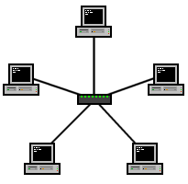
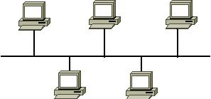
LAN Topology
Bus
  All nodes connected via a single cable
  Only one (pair) of machines can communicate at a time
  Contention
Star
  Hub, router or switch is central node
  Connects devices to a single point
Notes:
Contention occurs when two or more computers try to send packets on the network at the same time
Hubs are relatively simple: any signal received is sent to all connected nodes; nodes ignore packets not meant for them.
Both bus and hub based networks can suffer from contention. Nodes can act as packet sniffers too.
Switches send data to specific nodes (can broadcast to all nodes too)
Routers can often act as switches but might not allow broadcast. Routers also provide onward connections to other networks (e.g. Internet)
Local networks can be connected by bridges to other local networks or the internet.

Slide 16
Home and Small Office
Small home & office networks typically connect to internet via:
  Dial-in: modem uses standard phone line and exchange. Limited bandwidth.
  DSL (Digital Subscriber Line) requires updated machines at local exchange to offer higher speeds over a standard phone line
    Asynchronous DSL: Higher download than upload bandwidth
  Cable Internet uses cable television infrastructure to provide internet access
Notes:
HCW p326- 331

Slide 17
DSL vs Cable Internet
DSL
Cable Internet
Good availability
Phone and internet on one connection
Transmission rate affected by distance to exchange, quality of phone line, local exchange equipment
Big variance in performance
Limited availability
Separate connection
Cable originally designed for broadcast – high use can cause network congestion
Typically higher performance than DSL

Slide 18
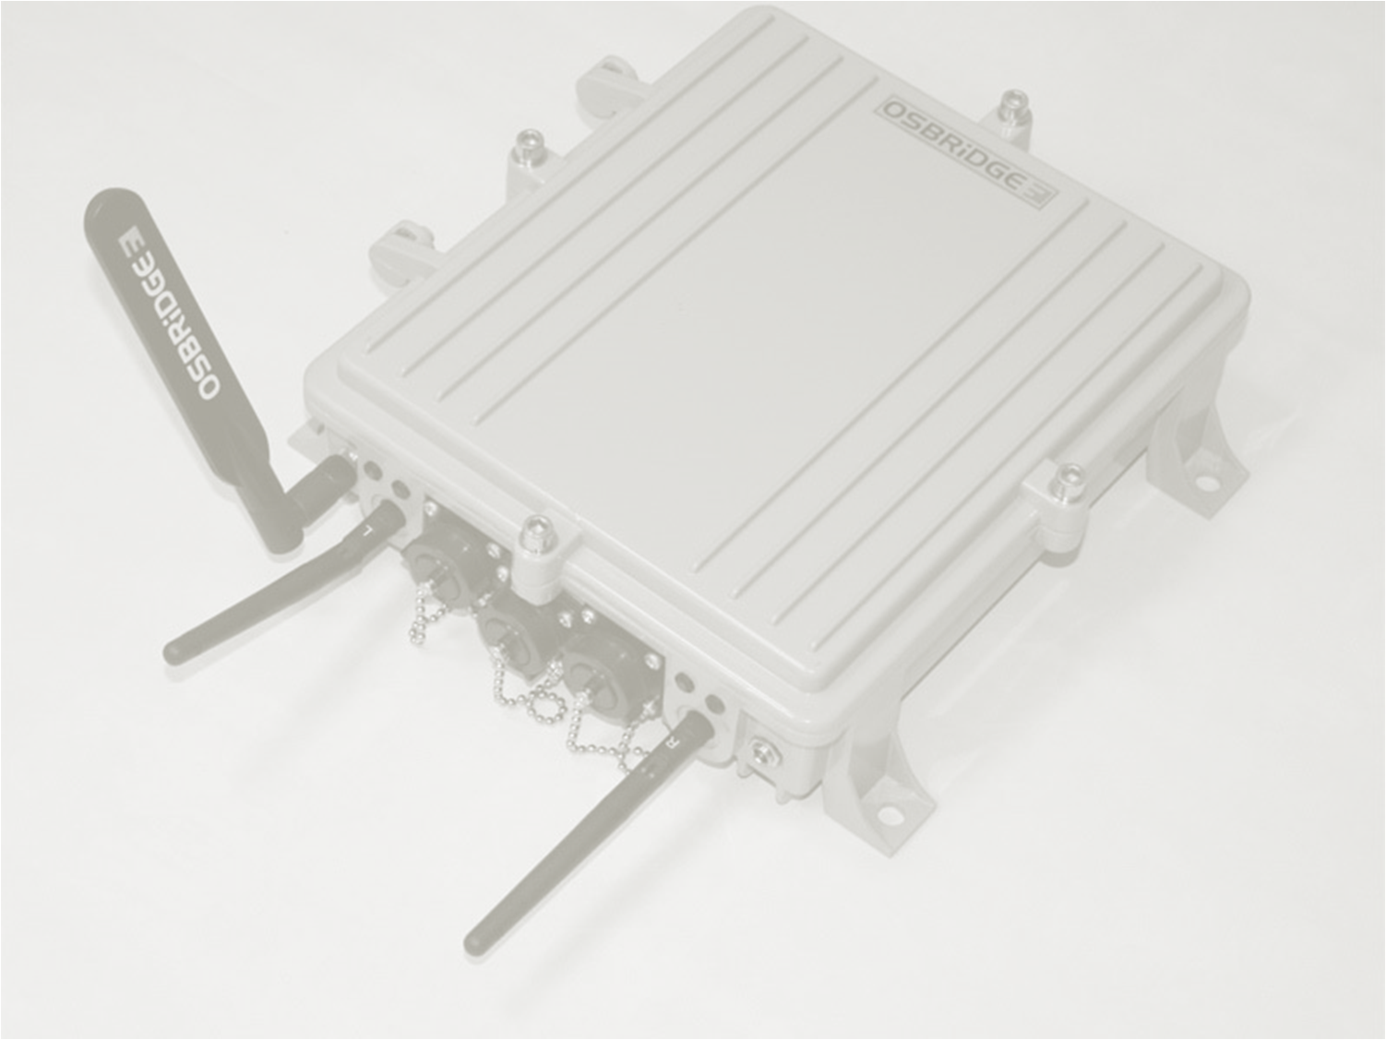
Wireless Internet
Wireless networking, IEEE802.11 a/b/g/n
Commonly built into laptops and now many home devices (e.g. PS3)
Need nearby access point (e.g. WiFi cable modem) ~30-50m
Unencrypted or unprotected WiFi connections can pose serious security risk
Notes:
HCW p352-3

Slide 19
Wireless Security
Wireless transmissions can be ‘heard’ by any listening device
  Not just the access point
Unencrypted messages can be easily copied
  WEP: Wired Equivalent Privacy
  Deprecated (not recommended for use) – one encryption key for all packets
  WPA & WPA-2: Wi-Fi Protected Access – uses a different encryption key for every data packet

Slide 20
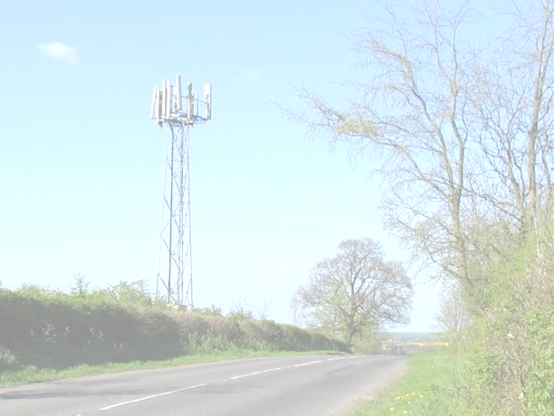
Mobile Internet
Early mobile web-access limited by small displays and expensive data-transfer rates
  WAP & WML – Wireless Access Protocol and Wireless Markup Language
Modern mobile internet on third and fourth generation networks (3g and 3.5g) provide higher bandwidth data rates
  To broadband equivalent rates
  Used in latest generations of Smartphones and for mobile internet access on laptops
Notes:
HCW p354-357

Slide 21
Feature | iOS | Android | webOS | Windows Phone | BlackBerry OS | Bada
Company | Apple | Open Handset Alliance (Google) | HP/Palm Inc | Microsoft | RIM | Samsung
OS Family | Mac OS X/Unix-like | Linux | Linux | Windows CE 7 | Mobile OS | *nix
CPU | ARM | ARM, MIPS, Power Architecture, x86 | ARM | ARM | ARM | ARM
Programmed in | C, C++, Objective-C | C, C++, Java | C | Many, .NET (Silverlight/XNA) | Java | C++
License | Proprietary + open source elements | Open source + closed source elements | Open source + closed source modules | Proprietary | Proprietary | Proprietary
Official SDK platform(s) | Mac OS X | Multi-platform | Multi-platform | Windows | Windows | Windows
Notes:
Table excerpted from http://en.wikipedia.org/wiki/Mobile_operating_system CC-BY-SA Wikimedia Foundation, multiple contributors
SDK platform refers to what hardware is used to develop for the phone, ie MAC OS X is the only official hardware that can be used to develop for iOS using the Software Development Kit (SDK)

Slide 22
The World Wide Web
Finding documents or resources on the internet was not always easy
Often required detailed knowledge of what computers were actually available, and where particular information was likely to be held
In 1989 Tim Berners-Lee proposed a hypertext based information sharing system for the internet
  Hypertext already existed, but not networked (e.g. Hypercard on Mac)
Notes:
1989: Tim Berners-Lee, a systems developer at CERN (Geneva) becomes frustrated at the difficulty of retrieving documents and information from different systems - proposes a hypertext based system to be run on-top of the internet:
The World Wide Web

Slide 23
Tim Berners-Lee: Birth of the Web
Interviewed for The Virtual Revolution, Tim Berners-Lee explains why he invented the World Wide Web:
  Video Here (Start at 6:05)
“I invented the web... because it was so frustrating that it didn’t exist”
  The problem was the lack of a common standard documentation system that allowed links between documents – even where the documents lived on different systems
Notes:
In the first six minutes of the video, Tim discusses how he got interested in computers more generally.
Perhaps of interest to this class as he followed computers as the technology developed: working first with simple relays and transistor circuits, then building his own simple computers out of ICs. Eventually working at CERN developing systems that would allow other (incompatible) systems to communicate and share data.

Slide 24
A Brief History of the Web
1990: First web-server, http://info.cern.ch
1993: Mosaic Browser brought graphical browsing to Mac & PC computers
1995: First edition of Bill Gates’ book “The Road Ahead” doesn’t mention the web at all
1999-2001: DotCom Boom and Bust
Today: The Ubiquitous Web

Slide 25
Web Terms
HTTP: HyperText Transport Protocol – the protocol used by browsers and servers to request and provide pages
HTML: HyperText Markup Language – markup language used to write web-pages
URL: Universal Resource Locator – each document or resource on the internet can have a unique URL that anyone to access that file
Notes:
HCW p 368

Slide 26
Web 2.0 and On...
The Web brought the internet into daily life and ordinary homes
  Access to information and services
Later generations of applications focussed less on letting users access information, more on letting users create their own
Blogs, wikis, social networks, ...
The read/write web
Notes:
Good questions here are to ask who has a Facebook account, who uses Wikipedia, who has ever edited or created a page on Wikipedia, etc...

Slide 27
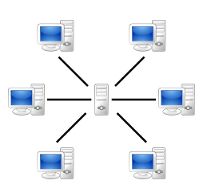
Client/Server
One machine on internet acts as a
server
One or more machines as clients
Examples:
  Chat or Instant messaging: User runs client program, which connects to a server run by AOL/Microsoft, etc
  Some multi-user games require one user to run as a server (dedicated or as client as well)
  MMO games (World Of Warcraft)

Slide 28
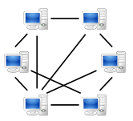
Peer To Peer
Made (in)famous by Napster
& illegal file-sharing
Many legitimate uses
Many P2P applications use a subset of peers to act as directories to allow peers to identify resources or other peers on the network
  E.g. Skype supernodes
  BitTorrent peers can be both seeders (providers of files) and trackers (directories)
Notes:
See HCW p340-343

Slide 29
Distributed Server Networks
Some applications may use maintain client/server distinction – but use distributed networks of servers
E.g. OpenSim Hypergrid
  OpenSim is an open source 3D virtual world platform: anyone can run a server to create their own small virtual world
  OpenSim virtual worlds can be linked
  Users can travel between worlds from a single client

Slide 30
Further Reading
Wikipedia:
  History of the Internet, TCP/IP, DSL, History of the World Wide Web, etc.
PCH:
  Chapter 14, Computer Communications

Slide 31
Required Reading For Next Week
HCW:
  Chapter 9: p132-143 (Bitmaps & Vector Images)
  Chapter 19 (Digital Cameras)
  Chapter 20 (Multimedia Sound)
  Chapter 21 (Multimedia Video)
  Chapter 29 (Internet Video/Audio)

Slide 32

This work by Daniel Livingstone at the University of the West of Scotland is licensed under the Creative Commons Attribution-ShareAlike 3.0 Unported License. To view a copy of this license, visit http://creativecommons.org/licenses/by-sa/3.0/ or send a letter to Creative Commons, 171 Second Street, Suite 300, San Francisco, California, 94105, USA.
Image Credits:
Title Image – CC-BY-SA Daniel Livingstone, 2011
World of Warcraft screenshot – CC-BY Juanpol, http://www.flickr.com/photos/juanpol/8232592/
Mobile phone GPS – CC-BY HawaiianMama http://commons.wikimedia.org/wiki/File:GPS_on_smartphone_cycling.JPG
Ethernet RJ-45 Connector – CC-BY-SA David Monniaux , http://en.wikipedia.org/wiki/File:Ethernet_RJ45_connector_p1160054.jpg
Network Topology: Bus, Public domain, from Wikimedia Commons, Star CC-BY-SA Head, http://commons.wikimedia.org/wiki/File:Netzwerktopologie_Stern.png
Network Topology/DataFlow CC-BY-SA Kbrose/Cburnett http://en.wikipedia.org/wiki/File:IP_stack_connections.svg
OSBridge WiFI access point, Public Domain by Rewt, http://en.wikipedia.org/wiki/File:3GN_.jpg
Client/Server network, Gnu LGPL by Maurio Bieg, http://commons.wikimedia.org/wiki/File:Server-based-network.svg
Peer to Peer Network, Public Domain by Maurio Bieg http://commons.wikimedia.org/wiki/File:P2P-network.svg
Telephone mast, CC-BY-SA Andrew Tatlow,
http://commons.wikimedia.org/wiki/File:Mobile_telephone_mast_-_geograph.org.uk_-_165771.jpg
Smartphone market share, CC-BY-SA Eraserhead1, http://en.wikipedia.org/wiki/File:Smartphone_share_current.png
Product names, logos, brands, and other trademarks featured or referred to within the these notes are the property of their respective trademark holders. These notes have been produced without affiliation, sponsorship or endorsement from the trademark holders.

